Slide 1
Network Layer NAT and PAT

Slide 2
NAT “ Network Address Translation”
Definition:
NAT translates private address to global address.
Purpose of NAT:
Solve problem of IP depletion.
Private IP Addresses:
Class | Number of Networks | Private Address Space
A | 1 | 10.0.0.0 – 10.255.255.255
B | 16 | 172.16.0.0 – 172.31.255.255
C | 256 | 192.168.0.0 – 192.168.255.255

Slide 3
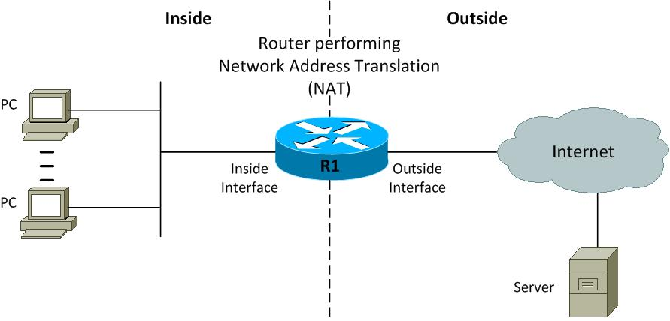
NAT Addresses:
Inside local addresses are assigned to inside devices. These addresses are not advertised to the outside (Private IP address of the host).
Inside global are addresses by which inside devices are known to the outside (Public IP address of the host).

Slide 4
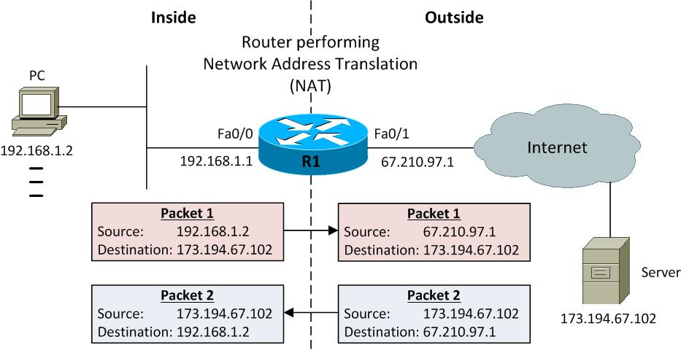
NAT Concept:
Inside Local (Private Address) | Inside Global (Registered Address)
192.168.1.2 | 67.210.97.1

Slide 5
Types of NAT:
Static NAT.
Dynamic NAT.
PAT “ Port Address Translation”

Slide 6
1) Static NAT:
Allowing one-to-one mapping between local and global addresses.
Static NAT requires you to have one registered public IP address for every host on your network.
Static NAT has no benefit in terms of IP address conservation.
It provides a degree of security by hiding the inside IP addresses from the outside world.

Slide 7
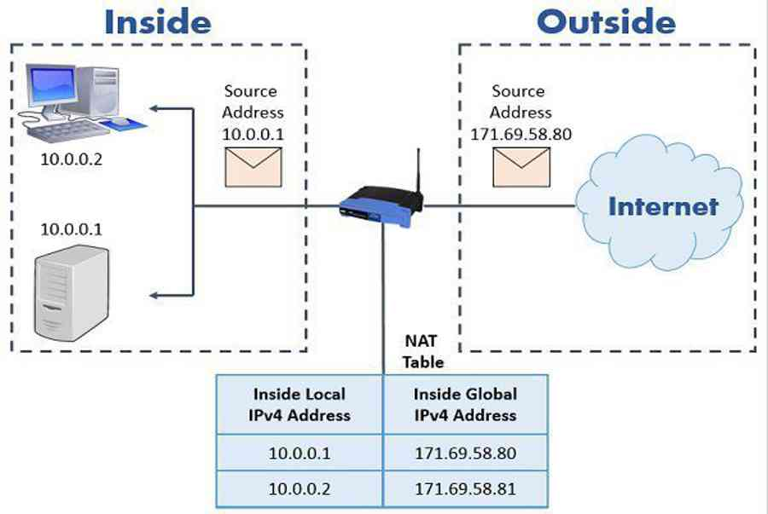
1) Static NAT:

Slide 8
2) Dynamic NAT:
Mapping unregistered private IP addresses to registered public IP addresses from a pool of available registered IP addresses.
You don’t have to statically configure your router to map an inside to an outside address as you would using static NAT.
If all inside global IP addresses are exhausted, any new request from new host will be discarded.
In dynamic NAT after certain period called timeout value, the router works a NAT remove host inside global from table if it is not in use.

Slide 9
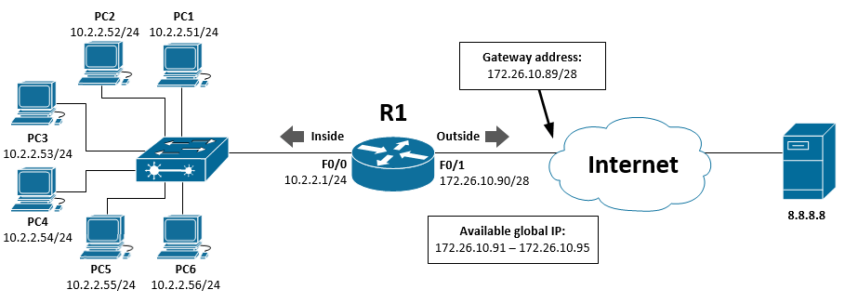
2) Dynamic NAT:

Slide 10
3) PAT “ Port Address Translation”:
This is the most popular NAT type.
Mapping multiple unregistered private IP addresses to a single registered public IP address.
It is a many-to-one mapping between private and public addresses and is accomplished using different port numbers.
Port number 16 bit (0 – 65535)
Well known ports (0 – 1023)
User defined ports: (1024 – 65535)
By using PAT, hundreds or even thousands of users can be connected to the Internet using only one real global IP address.

Slide 11
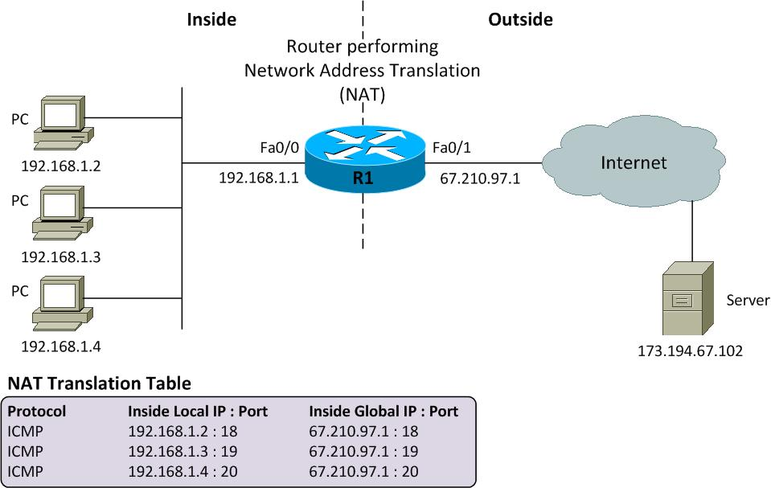
3) PAT “ Port Address Translation”:

